Slide 1



Identifying scientific problems and solutions: Semantic network analytics and deep learning
Lu Huang¹, Xiaoli Cao^{2,}*, Hang Ren¹, Chunze Zhang¹, Zhenxin Wu²
¹ School of Economics, Beijing Institute of Technology
² National Science Library, Chinese Academy of Sciences
2024.04.23

Slide 2
1 Motivation
The rapid increase in scientific articles lays a strong foundation for identifying problems and solutions in a field.
The intelligent mining of scientific problems and solutions aims to identify the real-world issues existing in the scientific and technological practices of a field, find corresponding solutions, and explore the underlying theoretical foundations.
It facilitates a deep exploration of the intrinsic logical relationships among research objects, problems, solutions, and fundamental principles.
Some scholars have mentioned that problems and corresponding solutions constitute the "key insights" within scientific articles.
Identifying scientific problems and solutions can:
help scholars map the scientific field;
enhance the speed of information retrieval and processing;
offer reference solutions for real-world issues in industrial practices.
How to identify scientific problems and solutions?
&
How to identify the correlation between scientific problems and solutions?

Slide 3
2 Related work
entity extraction
Many significant studies focus on extracting key viewpoints (e.g., research problems, and solutions) from scientific papers using entity extraction techniques.
However, these methods usually involve supervised learning on pre-annotated datasets, a process that requires significant resources for domain-specific annotation.
network analytics
Some scholars employ methods such as keyword network analysis and citation analysis to construct academic knowledge graphs, deeply exploring the relationships among knowledge entities in papers.
However, these researches ignore the specific semantic functions of keywords in different contexts, leading to a lack of accuracy in the representation of knowledge structures.
the BERT-CRF model is constructed to generate textual representations with enhancing semantics, and it is combined with BIO tagging to identify four entity types: research object, problem, solution, and fundamental principle, improving the accuracy of identifying entities；
the Levenshtein algorithm is applied to align entities, and the semantic relations and co-occurrence associations are integrated to construct knowledge network, comprehensively and accurately revealing the relationships between entities;
the combination of semantic network analytics and topological structure analytics are applied to thoroughly explore the correlations between the four entity types.
(1) Deep learning is an efficient technology for extracting information from complex unstructured data and converting data into vector representations;
(2) Semantic network analysis incorporates the rich semantic information of keywords into network analysis, providing a more intensive and accurate analysis for the mining of scientific problems and solutions.

Slide 4
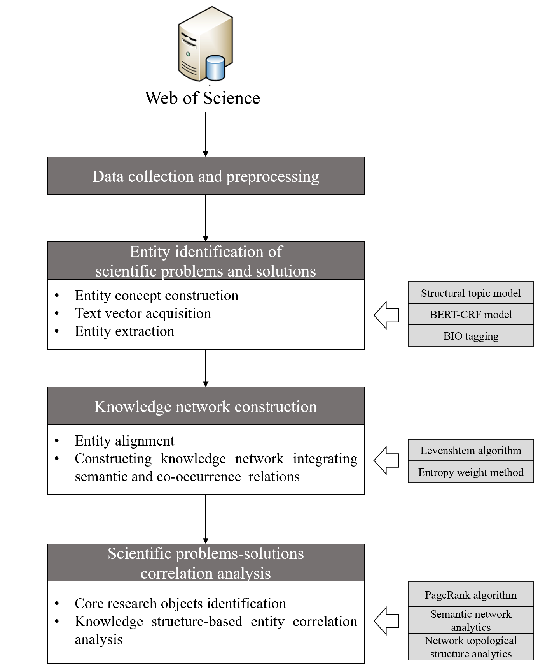
3 Methodology
Identifying scientific problems and solutions:
Semantic network analytics
&
Deep learning

Slide 5
3 Method-Entity identification of scientific problems and solutions
Entity concept construction based on Structural Topic Model
Download paper data for a field from the Web of Science；
Use VantagePoint and NLP techniques to process the dataset；
Construct the four abstract entity concepts based on the concept of Structural Topic Model (STM), which includes "research object", "problem", "solution" and "fundamental principle"；
"Research object" refers to the research subfields, serving as the starting point of the research; "problem" focuses on the scientific issues to be resolved and the goals to be achieved, jointly defining the problems space with the research object; "solution" describes the overall solution to the problem, representing the key steps towards achieving the goals; "fundamental principle" refers to the theoretical foundation underlying the solution methods. The four-entity concept constructed provides a comprehensive analytical framework reflecting the essence of research literature.
Use BIO tagging to identify the four types of entities in a small number of literatures and generate a pre-trained dataset.

Slide 6
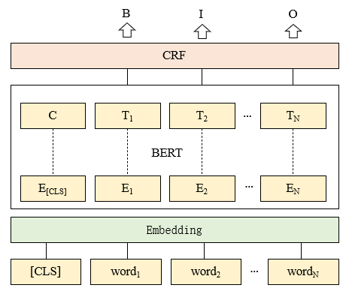
3 Method-Entity identification of scientific problems and solutions
Text vector acquisition based on BERT-CRF model
The BERT model is trained on each of the four types of entities by using a pre-training dataset；
Use the multi-head self-attention mechanism of BERT to better capture contextual semantic information；
Integrate the CRF model with BERT based on the embedding during the training process；
When the model converges, the well-trained BERT-CRF model is generated；
Use the well-trained model to transform the dataset into vector.

Slide 7
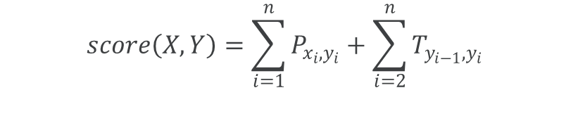
3 Method-Entity identification of scientific problems and solutions
Entity extraction
The well-trained BERT-CRF model is applied to process the text vectors using the SoftMax function, generating predicted labels corresponding to the text sequence.
Generate the probability distribution matrix corresponding to the text sequences.
Integrate BIO tagging into the CRF layer to generate four sequence labeling matrices of "research object", "problem", "solution" and "fundamental principle" based on the probability distribution matrix.
The entity categories corresponding to the text sequences are identified based on the sequence annotation results.
$$score\left(X,Y\right)=\sum_{i=1}^{n}{P_{x_{i},y_{i}}}+\sum_{i=2}^{n}{T_{y_{i−1},y_{i}}}$$

Slide 8
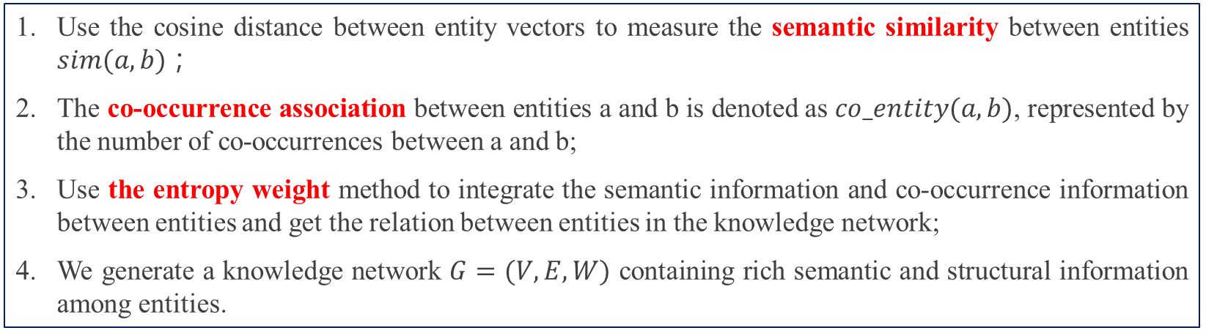
3 Method-Knowledge network construction
Entity alignment based on Levenshtein algorithm
Use the Levenshtein method for measuring the difference between two sequences to disambiguate；
Levenshtein algorithm can consider both the contextual information and semantic similarity, enhancing the accuracy of entity alignment.
Construct an entity dictionary based on expert knowledge, which is used for further checking and proofreading of entity alignment results.
Constructing knowledge network integrating semantic and co-occurrence relations
Use the cosine distance between entity vectors to measure the semantic similarity between entities $sim(a, b)$；
The co-occurrence association between entities a and b is denoted as $co_entity(a,b)$, represented by the number of co-occurrences between a and b;
Use the entropy weight method to integrate the semantic information and co-occurrence information between entities and get the relation between entities in the knowledge network;
We generate a knowledge network $G=(V, E, W)$ containing rich semantic and structural information among entities.

Slide 9
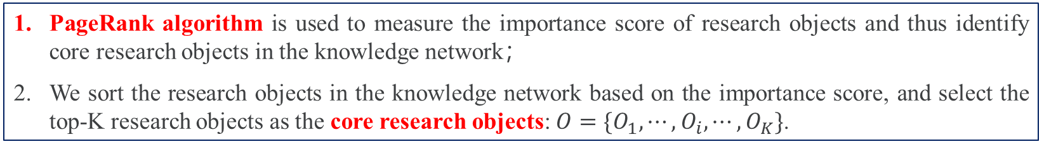
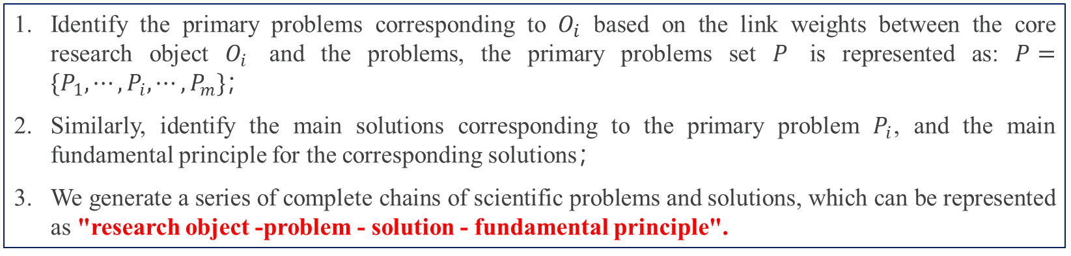
3 Method-Scientific problems-solutions correlation analysis
Core research objects identification based on PageRank algorithm
PageRank algorithm is used to measure the importance score of research objects and thus identify core research objects in the knowledge network；
We sort the research objects in the knowledge network based on the importance score, and select the top-K research objects as the core research objects: $O=\{O_{1},⋯,O_{i},⋯,O_{K}\}$.
Knowledge structure-based entity correlation analysis
Identify the primary problems corresponding to $O_{i}$ based on the link weights between the core research object $O_{i}$ and the problems, the primary problems set $P$ is represented as: $P=\{P_{1},⋯,P_{i},⋯,P_{m}\}$；
Similarly, identify the main solutions corresponding to the primary problem $P_{i}$, and the main fundamental principle for the corresponding solutions；
We generate a series of complete chains of scientific problems and solutions, which can be represented as "research object -problem - solution - fundamental principle".

Slide 10
4 Case study
Entity identification based on BERT-CRF model
Data source: Web of Science
Artificial Intelligence (2021-2023)
Total papers: 310456
Pre-training dataset: 3000
BIO tagging: "research object", "problem", "solution",
"fundamental principle"
Entity identification results:
Research object: 24254
Problem: 23839
Solution: 20670
Fundamental principle: 17550
BERT-CRF model:
Precision: 89.2%
Recall: 87.4%
F1-score: 88.3%

Slide 11
4 Case study
Constructing knowledge network in AI
Descriptive statistics of edges in knowledge network
 | Research object | Problem | Solution | Fundamental principle
Research object | / | 12683 | 9105 | 8468
Problem | 12683 | / | 17691 | 10565
Solution | 9105 | 17691 | / | 13783
Fundamental principle | 8468 | 10565 | 13783 | /
Entity identification results after entity alignment:
Research object: 887
Problem: 4136
Solution: 13858
Fundamental principle: 5518

Slide 12
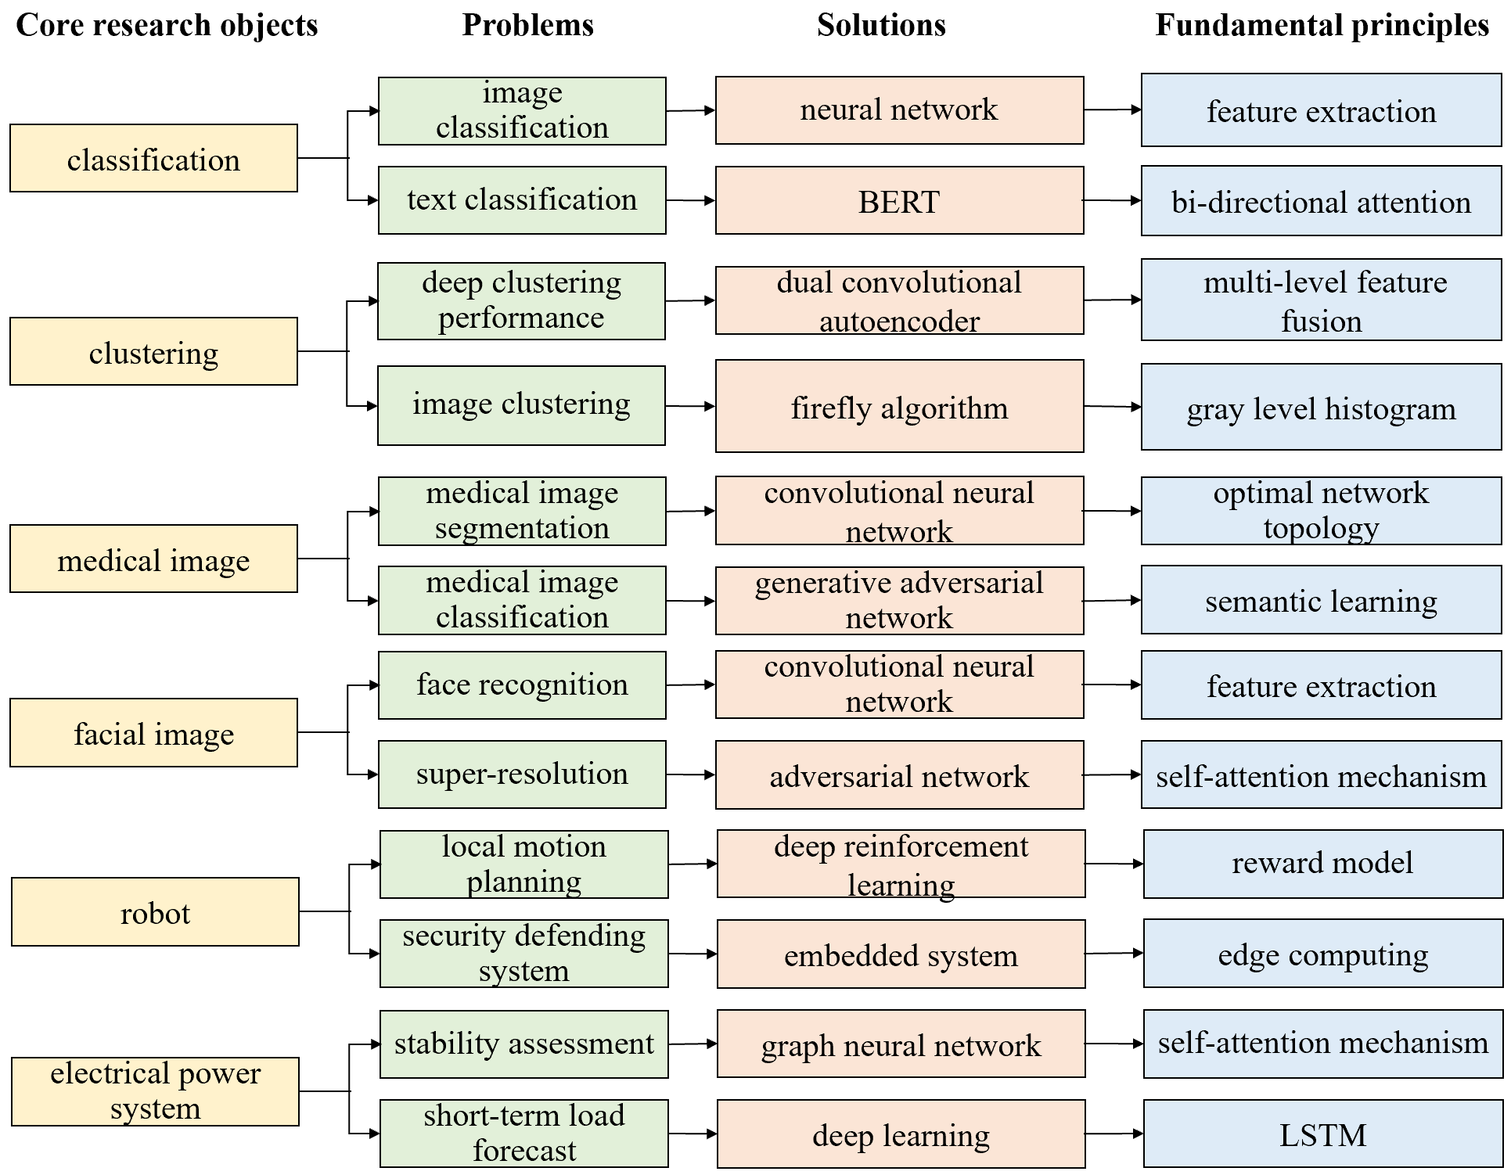
4 Case study
Several observations can be acquired based on the above results.
The research object represents a subfield, where the problems refer to the issues contained within that subfield, the solution refers to the methods or technologies required to solve the problems, and the fundamental principles refer to the inherent principles involved in the implementation process of the methods and technologies.
The "research object" and "problem" together constitute the complete scientific problem, and the "solution" and "fundamental principle" together constitute the complete solution.

Slide 13
4 Case study
For example, for the identified "classification - image classification - neural network – feature extraction", it refers that the neural network can be used to solve image classification problems through feature extraction.
This paper identifies a complete chain of "research object - problem - solution - fundamental principle".
On the one hand, it can identify the core research objects and corresponding primary problems in the field of artificial intelligence.
On the other hand, it is able to detect the corresponding solutions to the real problems in the scientific and technological practice and explore the theoretical basis behind them, and thus realize the in-depth excavation of the intrinsic logical connection among scientific problems, solutions and fundamental principles.

Slide 14
4 Case study-Validation
Verification of the trained BERT-CRF model
This paper conducted the quantitative and qualitative methods to verify the reliability of our proposed method and entity correlation identification results.
To quantitatively verify the advantages of the BERT-CRF model trained in this paper we select three advanced models, ALBERT, SciBERT, and XLNet, for comparison experiments.
Referencing the model parameters of BERT-CRF in this paper, the three models were fine-tuned respectively to achieve the optimal effect.
Parameter configurations of models
 | Our method | ALBERT | SciBERT | XLNet
Maximum input length | 64 | 64 | 64 | 64
Training epoch | 30 | 40 | 30 | 35
Batch size | 4 | 16 | 4 | 8
Number of layers | 12 | 12 | 12 | 12
Learning rate | 1e-5 | 5e-6 | 1e-5 | 1e-6
CRF learning rate multiplier | 100 | / | 50 | /

Slide 15
4 Case study-Validation
Verification of the trained model
Methods | Research objects |  | Problems |  | Solutions |  | Fundamental principles
 | Recall | Precision | Recall | Precision | Recall | Precision | Recall | Precision
Our method | 0.980 | 0.965 | 0.964 | 0.942 | 0.856 | 0.877 | 0.724 | 0.759
ALBERT | 0.934 | 0.936 | 0.924 | 0.896 | 0.848 | 0.815 | 0.638 | 0.702
SciBERT | 0.928 | 0.955 | 0.906 | 0.883 | 0.834 | 0.827 | 0.704 | 0.740
XLNet | 0.962 | 0.919 | 0.944 | 0.907 | 0.838 | 0.859 | 0.680 | 0.741
Results: Our method outperforms baseline methods in two evaluation indicators.
Research objects: the Recall value increases by 4.6%, 5.2%, and 1.8%, respectively, and the Precision value increases by 2.9%, 1.0%, and 4.6%, respectively.
Problems: the Recall value increases by 4.0%, 5.8%, and 2.0%, respectively, and the Precision value increases by 4.6%, 5.9%, and 3.5%, respectively.
Solutions: the Recall value increases by 0.8%, 2.2%, and 1.8%, respectively, and the Precision value increases by 6.2%, 5.0%, and 1.8%, respectively.
Fundamental principles: the Recall value increases by 8.6%, 2.0%, and 4.4%, respectively, and the Precision value increases by 5.7%, 1.9%, and 1.8%, respectively.

Slide 16
4 Case study-Validation
Verification of entity correlation identification
Relevant documentary proof of partial entity correlation identification results
No | Research object - problem - solution - fundamental principle | Relevant documentary proof
1 | classification - image classification - neural network – feature extraction | In 2021, Nadendla et al. proposed a neural network-based classifier by feature extraction and classification to solve the image classification problem [36].
2 | clustering - deep clustering performance - dual convolutional autoencoder - multi-level feature fusion | In 2022, Hou et al. used a dual convolutional autoencoder to extract features of multi-levels and fuse them to improve the performance of deep clustering [40].
3 | medical image - medical image segmentation - convolutional neural network - optimal network topology | In 2024, Tamilmani et al. used the convolutional neural network with the optimal network topology to solve the problem of medical image segmentation [41].
4 | facial image - face recognition - convolutional neural network - feature extraction | In 2022, Wei-Jie et al. applied the convolutional neural network by extracting the masked face features to solve the problem of masked facial recognition [42].
5 | robot - local motion planning - deep reinforcement learning - reward model | In 2023, Garrote et al. proposed a deep reinforcement learning strategy based on a reward model to solve the local motion planning problem of robots [43].
6 | electrical power system - stability assessment - graph neural network - self-attention mechanism | In 2022, Gu et al. used the graph neural network based on the self-attention mechanism to evaluate the stability of the power system [44].

Slide 17


5 Conclusions
Future Directions
Highlights
the deep learning method was applied to extract textual semantic information and identify entities, capturing the hidden semantic association in different textual contexts effectively, and improving the accuracy of the entity recognition.
Further research should be conducted based on more data sources, including papers, patents, and product data.
More advanced methods and professional expert knowledge could be introduced in the future to improve the efficiency and quality of entity alignment.
the machine learning method was used to construct the knowledge network, fully considering the knowledge structure and semantic structure between entities, and thus containing more abundant information.
The evolution mechanism of "research object - problem - solution - fundamental principle" needs to be further explored.
the PageRank algorithm and semantic network analytics were introduced to deeply explore the linkages among research objects, problems, solutions, and fundamental principles.

Slide 18
Thanks for your listening

